Slide 1
Graphs
CS 400/600 – Data Structures

Slide 2
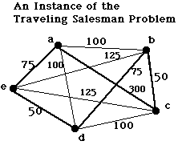
Graphs
Used to represent all kinds of problems
  Networks and routing
  State diagrams
  Flow and capacity

Slide 3
Graph Definitions
A graph G = (V, E) consists of a set of vertices V, and a set of edges E
  Each edge is connection between two vertices
A graph can be directed or undirected, weighted or unweighted, labeled or unlabeled.
D
V = {A, B, C, D, E}
E = {(A,B), (B,D), (B,E),
(D,A), (E,C)}
|V| = # of vertices,
|E| = # of edges.
A
B
E
C

Slide 4
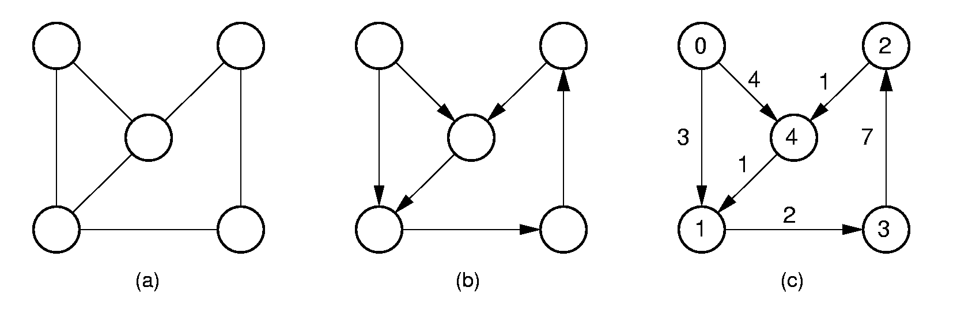
More definitions
Adjacent vertices are joined by an edge
A path from v₁ to v_{n} exists if there are edges from v₁ to v₂ to … to v_{n}.
  Simple path – all vertices distinct
  A cycle is a path from a vertex to itself

Slide 5
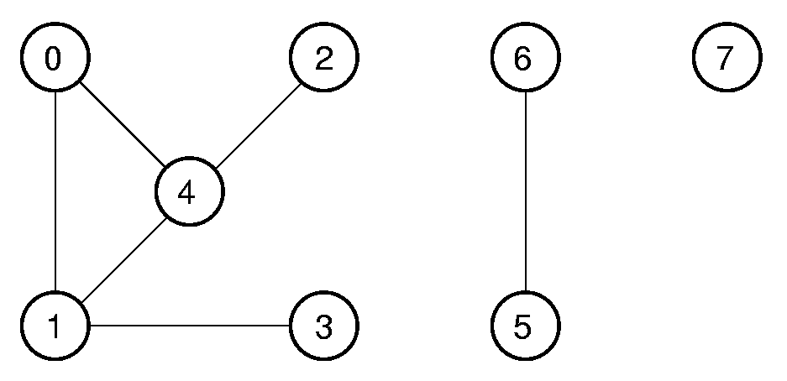
Connected Components
An undirected graph is connected if there is at least one path from any vertex to any other.
The maximum connected subgraphs of an undirected graph are called connected components.

Slide 6
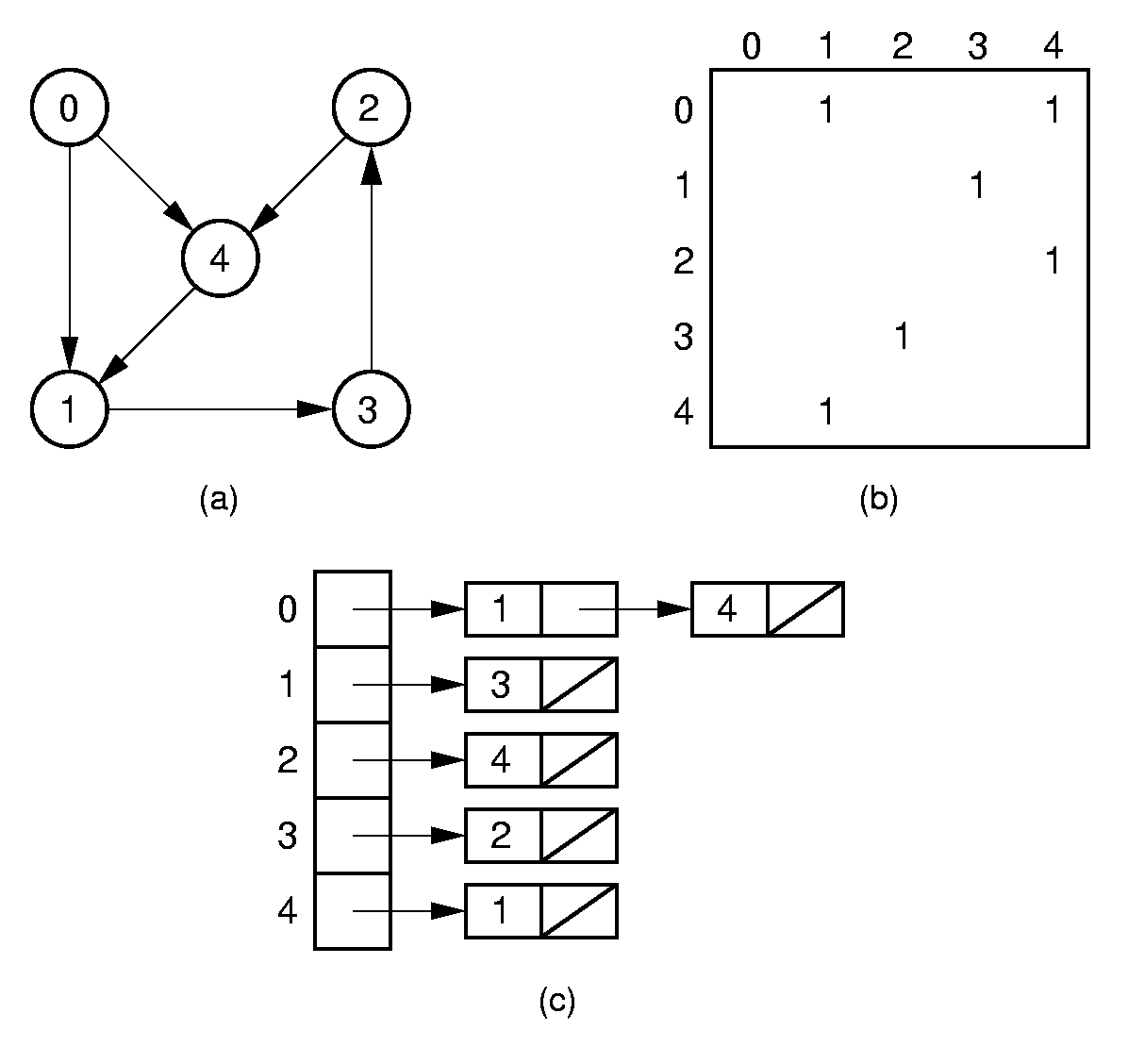
Directed Representation
Adjacency matrix: |V| by |V|
Adjacency list: a linked list of edges for each vertex.

Slide 7
Undirected Representation
Generally the same representations as for digraphs, but edges are entered in both directions.

Slide 8
Representation Costs
Adjacency matrix: O(|V|²)
Adjacency list: O(|V| + |E|)
|E| can be as low as 0, or as high as |V|²
The best representation depends on how densely connected the graph is (i.e. how many edges there are).

Slide 9
Graph ADT
class Graph { // Graph abstract class
public:
virtual int n() =0; // # of vertices
virtual int e() =0; // # of edges
// Return index of first, next neighbor
virtual int first(int) =0;
virtual int next(int, int) =0;
// Store new edge (from, to, weight)
virtual void setEdge(int, int, int) =0;
// Delete edge defined by two vertices
virtual void delEdge(int, int) =0;
// Weight of edge connecting two vertices
virtual int weight(int, int) =0;
virtual int getMark(int) =0;
virtual void setMark(int, int) =0;
};

Slide 10
Graph Traversals
Some applications require visiting every vertex in the graph exactly once.
The application may require that vertices be visited in some special order based on graph topology.
Examples:
  Artificial Intelligence Search
  Shortest paths problems

Slide 11
Graph Traversals (2)
To insure visiting all vertices:
void graphTraverse(const Graph* G) {
for (v=0; v<G->n(); v++)
G->setMark(v, UNVISITED); // Initialize
for (v=0; v<G->n(); v++)
if (G->getMark(v) == UNVISITED)
doTraverse(G, v);
}
We can’t just follow edges, because the graph may not be connected, and it may include cycles.
Notes:
doTraverse might be implemented by any of the graph traversals that we are about to discuss.

Slide 12
Depth First Search (1)
// Depth first search
void DFS(Graph* G, int v) {
PreVisit(G, v); // Take action
G->setMark(v, VISITED);
for (int w=G->first(v); w<G->n();
w = G->next(v,w))
if (G->getMark(w) == UNVISITED)
DFS(G, w);
PostVisit(G, v); // Take action
}

Slide 13
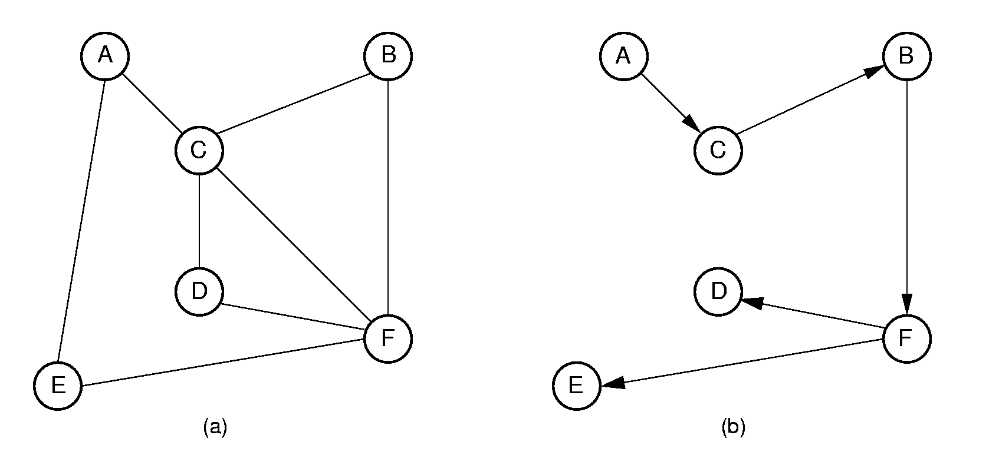
Depth First Search (2)
Cost: Θ(|V| + |E|).
Notes:
Order that nodes are processed: ACBFDE

Slide 14
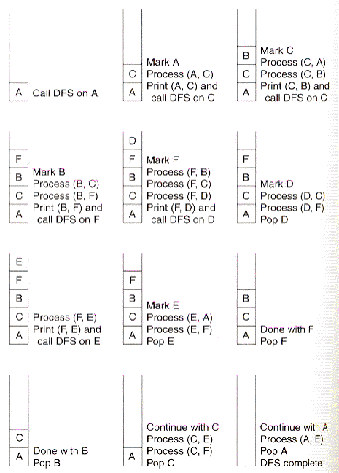
Depth First Search (3)
Notes:
Order that nodes are processed: ACBFDE

Slide 15
Breadth First Search (1)
Like DFS, but replace stack with a queue.
  Visit vertex’s neighbors before continuing deeper in the tree.
Notes:
Order that nodes are processed: ACBFDE

Slide 16
Breadth First Search (2)
void BFS(Graph* G, int start,Queue<int>*Q) {
int v, w;
Q->enqueue(start); // Initialize Q
G->setMark(start, VISITED);
while (Q->length() != 0) { // Process Q
Q->dequeue(v);
PreVisit(G, v); // Take action
for(w=G->first(v);w<G->n();w=G->next(v,w))
if (G->getMark(w) == UNVISITED) {
G->setMark(w, VISITED);
Q->enqueue(w);
}
PostVisit(G, v); // Take action
}
}
Notes:
Order that nodes are processed: ACBFDE

Slide 17
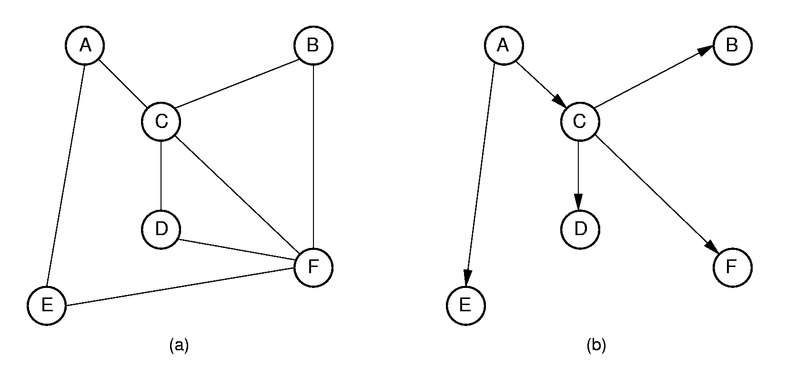
Breadth First Search (3)
Notes:
Order that nodes are processed: ACBFDE

Slide 18
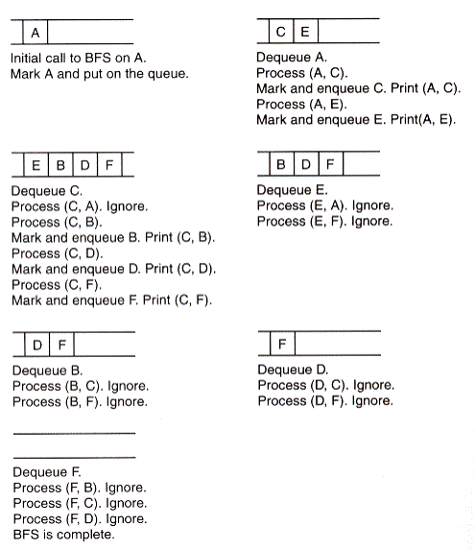
Breadth First Search (4)
Notes:
Order that nodes are processed: ACBFDE

Slide 19
Topological Sort (1)
Problem: Given a set of jobs, courses, etc., with prerequisite constraints, output the jobs in an order that does not violate any of the prerequisites.

Slide 20
Topological Sort (2)
void topsort(Graph* G) { // Topological sort
int i;
for (i=0; i<G->n(); i++) // Initialize
G->setMark(i, UNVISITED);
for (i=0; i<G->n(); i++) // Do vertices
if (G->getMark(i) == UNVISITED)
tophelp(G, i); // Call helper
}
void tophelp(Graph* G, int v) { // Process v
G->setMark(v, VISITED);
for (int w=G->first(v); w<G->n();
w = G->next(v,w))
if (G->getMark(w) == UNVISITED)
tophelp(G, w);
printout(v); // PostVisit for Vertex v
}

Slide 21
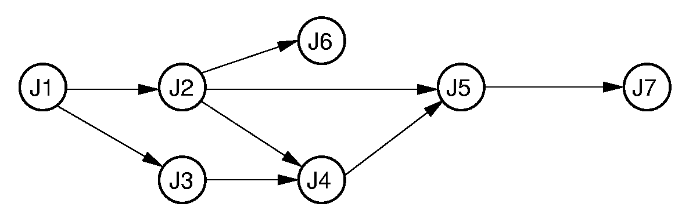
Topological Sort (3)
Algorithm prints: J7, J5, J4, J6, J2, J3, J1
Sort: J1, J3, J2, J6, J4, J5, J7
Notes:
Prints in reverse order.

Slide 22
Shortest Paths Problems
Input: A graph with weights or costs associated with each edge.
Output: The list of edges forming the shortest path.
Sample problems:
  Find shortest path between two named vertices
  Find shortest path from S to all other vertices
  Find shortest path between all pairs of vertices
We will actually calculate only distances.

Slide 23
Shortest Paths Definitions
d(A, B) = the shortest distance (so far) from vertex A to B.
w(A, B) = the weight of the edge connecting A to B.
If there is no such edge, then w(A, B) = ∞.
Notes:
w(A, D) = 20; d(A, D) = 10 (through ABCD).

Slide 24
Dijkstra’s Algorithm
D(x) = distance from s to x (initially all ∞)
Select the closest vertex to s, according to the current estimate (call it c)
Recompute the estimate for every other vertex, x, as the MINIMUM of:
  The current distance, or
  The distance from s to c , plus the distance from c to x – D(c) + W(c, x)

Slide 25
Dijkstra’s Algorithm Example
 | A | B | C | D | E
Initial | 0 | ∞ | ∞ | ∞ | ∞
Process A | 0 | 10 | 3 | 20 | ∞
Process C | 0 | 5 | 3 | 20 | 18
Process B | 0 | 5 | 3 | 10 | 18
Process D | 0 | 5 | 3 | 10 | 18
Process E | 0 | 5 | 3 | 10 | 18
B
5
D
10
20
A
11
3
2
C
15
E

Slide 26
Dijkstra’s Implementation
// Compute shortest path distances from s,
// return them in D
void Dijkstra(Graph* G, int* D, int s) {
int i, v, w;
for (i=0; i<G->n(); i++) { // Do vertices
v = minVertex(G, D);
if (D[v] == INFINITY) return;
G->setMark(v, VISITED);
for (w=G->first(v); w<G->n();
w = G->next(v,w))
if (D[w] > (D[v] + G->weight(v, w)))
D[w] = D[v] + G->weight(v, w);
}
}

Slide 27
Implementing minVertex
// Find min cost vertex
int minVertex(Graph* G, int* D) {
int i, v;
// Set v to an unvisited vertex
for (i=0; i<G->n(); i++)
if (G->getMark(i) == UNVISITED)
{ v = i; break; }
// Now find smallest D value
for (i++; i<G->n(); i++)
if ((G->getMark(i) == UNVISITED) &&
(D[i] < D[v]))
v = i;
return v;
}
How else might we get the minimum distance vertex for each iteration?

Slide 28
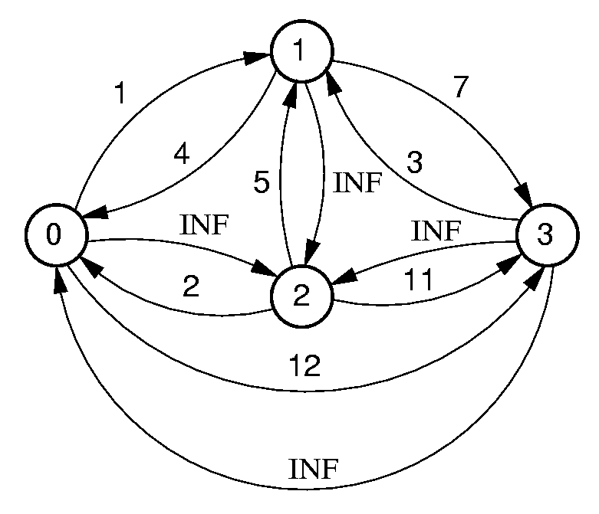
All-Pairs Shortest Paths
For every vertex u, v ∈ V, calculate d(u, v).
Could run Dijkstra’s Algorithm |V| times.
Better is Floyd’s Algorithm.
Define a k-path from u to v to be any path whose intermediate vertices all have indices less than k.
Notes:
Floyd’s algorithm is an example of dynamic programming. The issue is how to efficiently check all the paths without computing any path more than once.
1, 3 is a 0-path, since no vertices intervene. 2, 0, 3 is a 1-path since the highest-valued vertex (aside from the endpoints) is 0. 0, 2, 3 is a 3-path, but not a 2- or 1-path. All paths are 4-paths.

Slide 29
Floyd’s Algorithm
//Floyd's all-pairs shortest paths algorithm
void Floyd(Graph* G) {
int D[G->n()][G->n()]; // Store distances
for (int i=0; i<G->n(); i++) // Initialize
for (int j=0; j<G->n(); j++)
D[i][j] = G->weight(i, j);
// Compute all k paths
for (int k=0; k<G->n(); k++)
for (int i=0; i<G->n(); i++)
for (int j=0; j<G->n(); j++)
if (D[i][j] > (D[i][k] + D[k][j]))
D[i][j] = D[i][k] + D[k][j];
}

Slide 30
Minimal Cost Spanning Trees
Minimal Cost Spanning Tree (MST) Problem:
  Input: An undirected, connected graph G.
  Output: The subgraph of G that
  1) has minimum total cost as measured by summing the values of all the edges in the subset, and
  2) keeps the vertices connected.

Slide 31
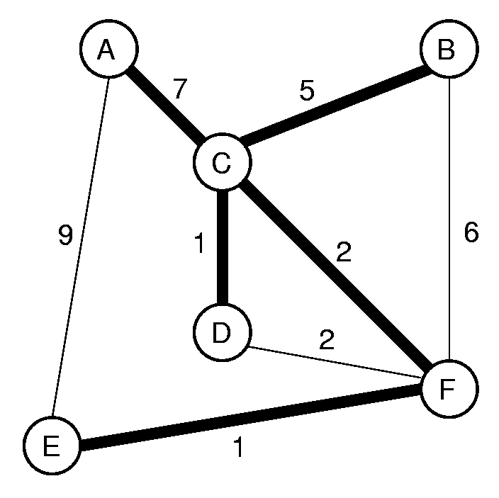
MST Example

Slide 32
Prim’s Algorithm
Pick any starting vertex N
Pick the least-cost edge from N to new vertex M, add (N, M) to the tree
Repeat:
  Pick the least cost edge from any vertex in the tree to any vertex not in the tree
  Add it to the tree
Until done

Slide 33
Prim’s MST Algorithm
void Prim(Graph* G, int* D, int s) {
int V[G->n()]; // Who's closest
int i, w;
for (i=0; i<G->n(); i++) {// Do vertices
int v = minVertex(G, D);
G->setMark(v, VISITED);
if (v != s) AddEdgetoMST(V[v], v);
if (D[v] == INFINITY) return;
for (w=G->first(v); w<G->n();
w = G->next(v,w))
if (D[w] > G->weight(v,w)) {
D[w] = G->weight(v,w);// Update dist
V[w] = v; // Update who it came from
}
}
}
Notes:
This is an example of a greedy algorithm. Note that its only difference from Dijkstra’s algorithm is in the distance computation. Dijkstra’s algorithm distance is shortest distance from source to vertex in question. Prim’s algorithm distance is shortest distance from any vertex now in the MST to the vertex in question.

Slide 34
Implementing Prim’s
A B C D E F
Mark:
✓
✓
✓
✓
✓
✓
A
A A A
A B C D E F
A C C D E F
A C C C A C
A C C D F F
V[]:
A C C D A C
D[]:
0 ∞ ∞ ∞ ∞ ∞
A
0 ∞ 7 ∞ 9 ∞
C
0 5 0 1 9 2
D
0 5 0 0 9 2
F
0 5 0 0 1 0
E
0 5 0 0 0 0
B
0 0 0 0 0 0

Slide 35
Implementing minVertex
Same issues as Dijkstra’s algorithm:
  How to get the minimum distance vertex at each step
  Not from the source, but from any node in the tree so far

Slide 36
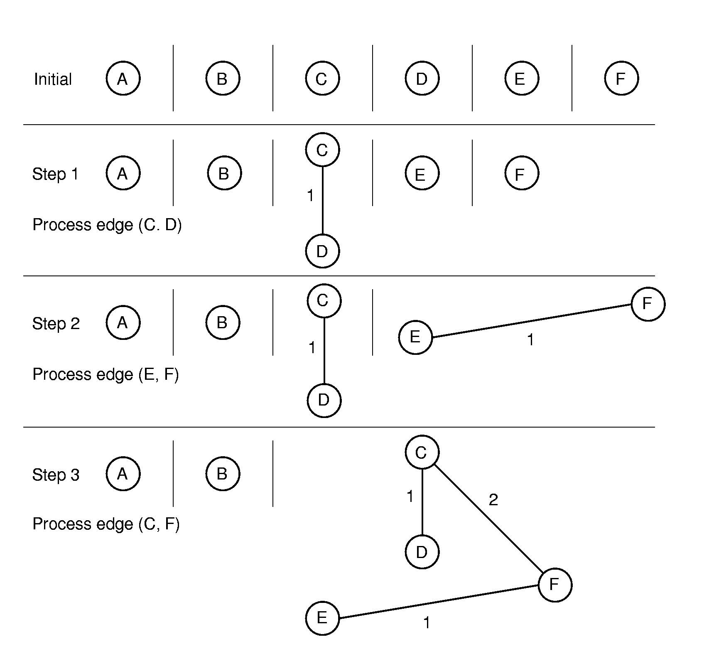
Kruskal’s MST Algorithm (1)

Slide 37
Kruskal’s MST Algorithm (2)
Initially, each vertex is in its own MST.
Merge two MST’s that have the shortest edge between them.
  Use a priority queue to order the unprocessed edges. Grab next one at each step.
How to tell if an edge connects two vertices already in the same MST?
  Use the UNION/FIND algorithm with parent-pointer representation.

Slide 38
Kruskal’s MST Algorithm (3)
Cost is dominated by the time to remove edges from the heap.
  Can stop processing edges once all vertices are in the same MST
Total cost: Θ(|V| + |E| log |E|).

